Slide 1
Teacher AI
TEAM: Milanesiimbruttiti

Slide 2
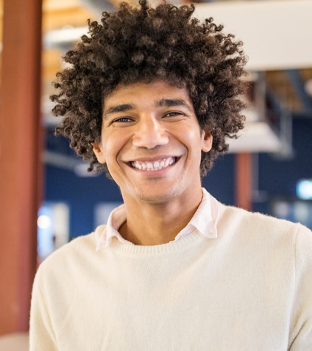
Team
Andrea Ierardi
Matteo Pasotti
Marco Vinciguerra
Alessandro Belotti
Alessio Galluccio

Slide 3

Introduction
Teacher AI is a web application with a professor generated by Artificial Intelligence. It presents elementary lesson about different topics: English, Science and Math. The objective is to guarantee education in different part of the world, especially countries that do not guarantee a decent level of education for children.

Slide 4
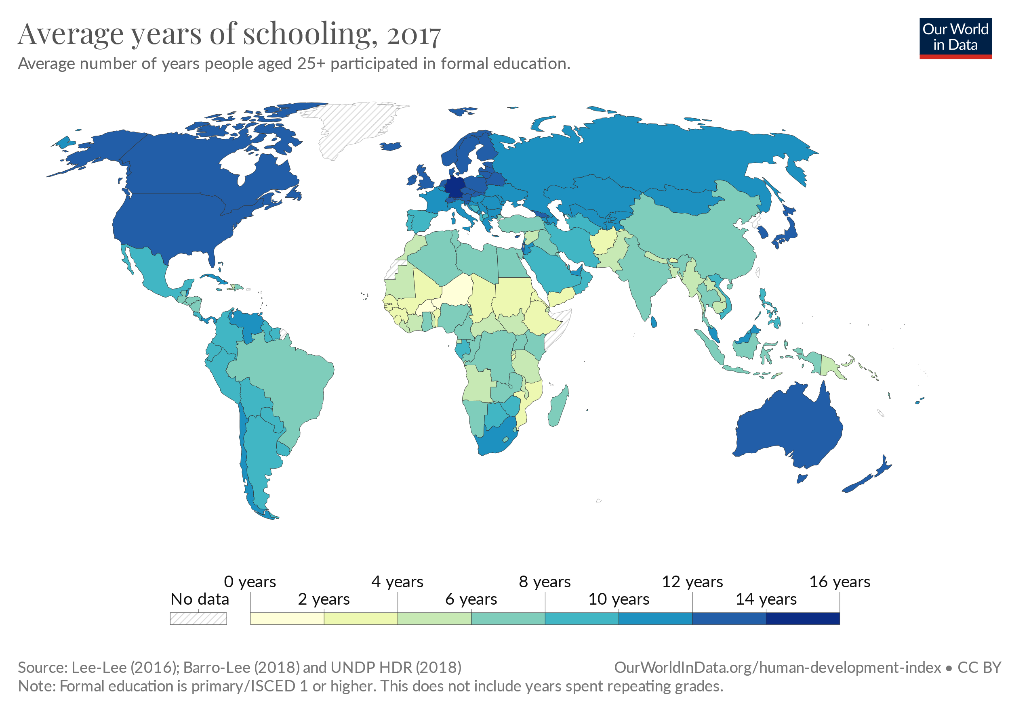
The issue: same world but different educational level
Source: Global Education - Our World in Data

Slide 5
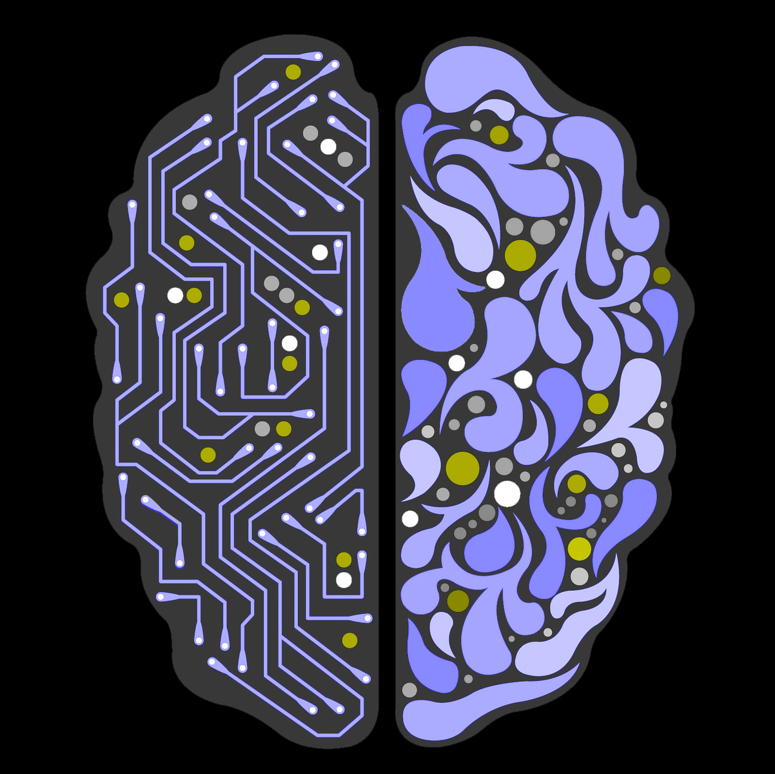
Our solution
Develop a Web App to help the spread of knowledge among children in underdeveloped countries and where there is no availability of teachers.
Teacher AI can take a leisure by a given sillabus, it can organize lessons weeks by weeks.

Slide 6
Business Plan
Since Teacher AI is a no profit organization, all the revenue will be invested in the platform with the aim to share knowledge and gain educational level in the third-world.
The source of income should come from a person able to afford the donation of a subscription to a person in need
Possible price can be a donation of 7,99 USD /month minimun for one person and 19,99USD/month for three people.
→ The Price is based on the cost of Api and management cost.

Slide 7
Tools and Models
Tools
Models
Jupyter Notebook for primary experimental phase
Streamlit to create and deploy the WebApp
Pyttsx3 package to speak
ChatGPT for generating syllabus
GPT3 to generate text of the lesson

Slide 8
How it works
The headmaster chooses the subject in the select box.
Teacher AI takes the topics from the sillabus selected and ask to GPT the explanation about it.
When the system gets the response, it’s read with the pyttsx3 function.

Slide 9
DEMO
You can try our prototype at the following link: Streamlit

Slide 10
AI Teacher Project
Target
Make
Children between 5-12 in underdeveloped countries
Children in every part of the world that need an educational reinforcement
Improve quality of education
Guarantee a decent level of education in every part of the world
Educate children on Artificial Intelligence

Slide 11

Future Steps
Implement with ChatGPT API
Allow the possibility to add custom syllabus by a children tutor

